Slide 1
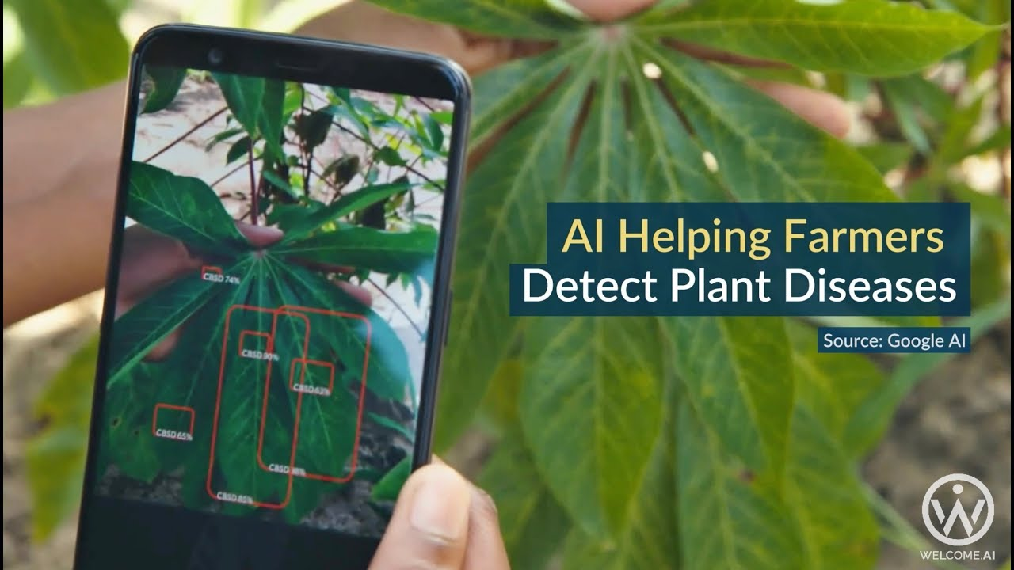
Plant Leaf Disease Detection and Classification
by
Priya Rajpurohit - 2015073
Sakshi Saini - 2017092

Slide 2
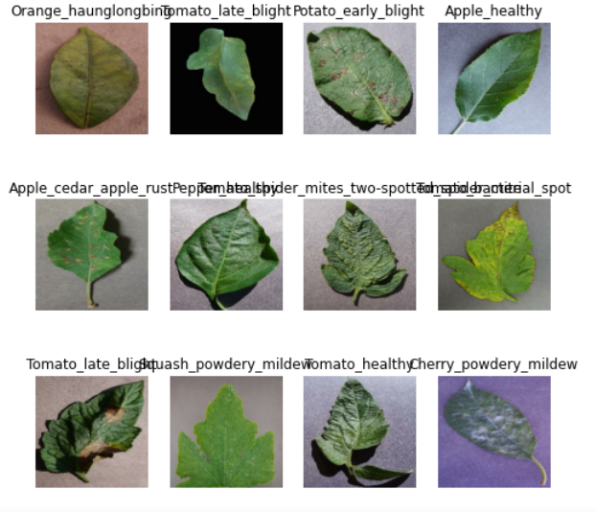
Problem Statement/Motivation
Agriculture was the key development in the rise of sedentary human civilization. The main problem faced by the agriculturist is the diseases in plants (which is quite normal). But if the proper care is not taken care of this can lead to serious problems like the low quality of crop production, quantity, or productivity is highly affected. With recent advancements in Neural Networks and computer vision, if we can use these architectures to detect the disease in early stages we can use the proper pesticides and preserve the crops.

Slide 3
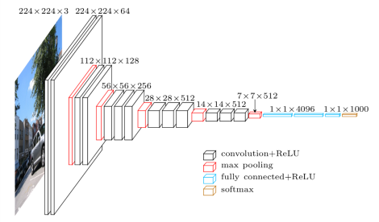
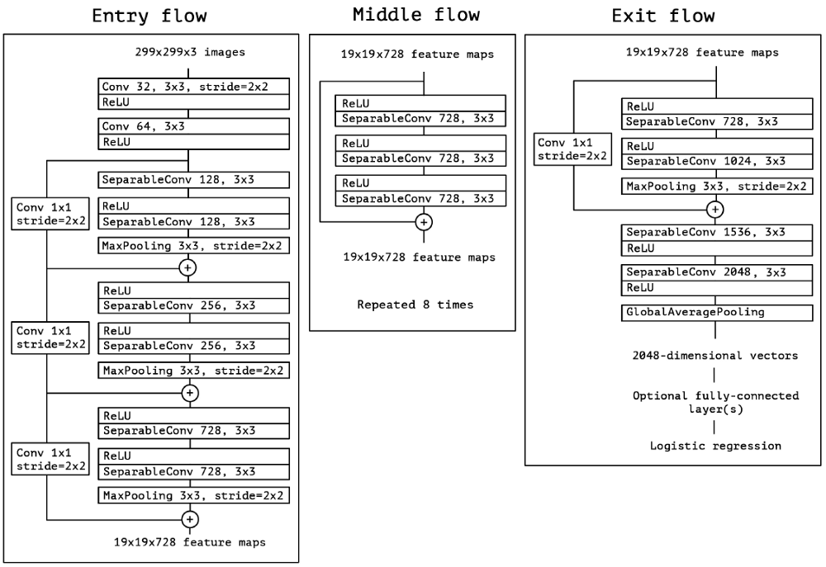
Proposed Architecture
Our main goal was to classify the leaf images as whether they are diseased or healthy and if diseased what disease they have. We have a total of 38 classes in which 12 of them are healthy classes and 26 are disease classes. We applied the methodology of Image Segmentation to remove the background of the images before applying the models. We trained the complete dataset on GoogleNet and AlexNet from scratch. Used transfer learning for the models (Resnet50, Inception v3, Xception, VGG16) trained only the last 3 layers/added a few extra trainable layers, checked the performance. Used (Resnet50, Inception v3, Xception, VGG16) as feature extractor and used Random forest and SVM as classifiers.
VGGNet 16 architecture
Xception architecture

Slide 4
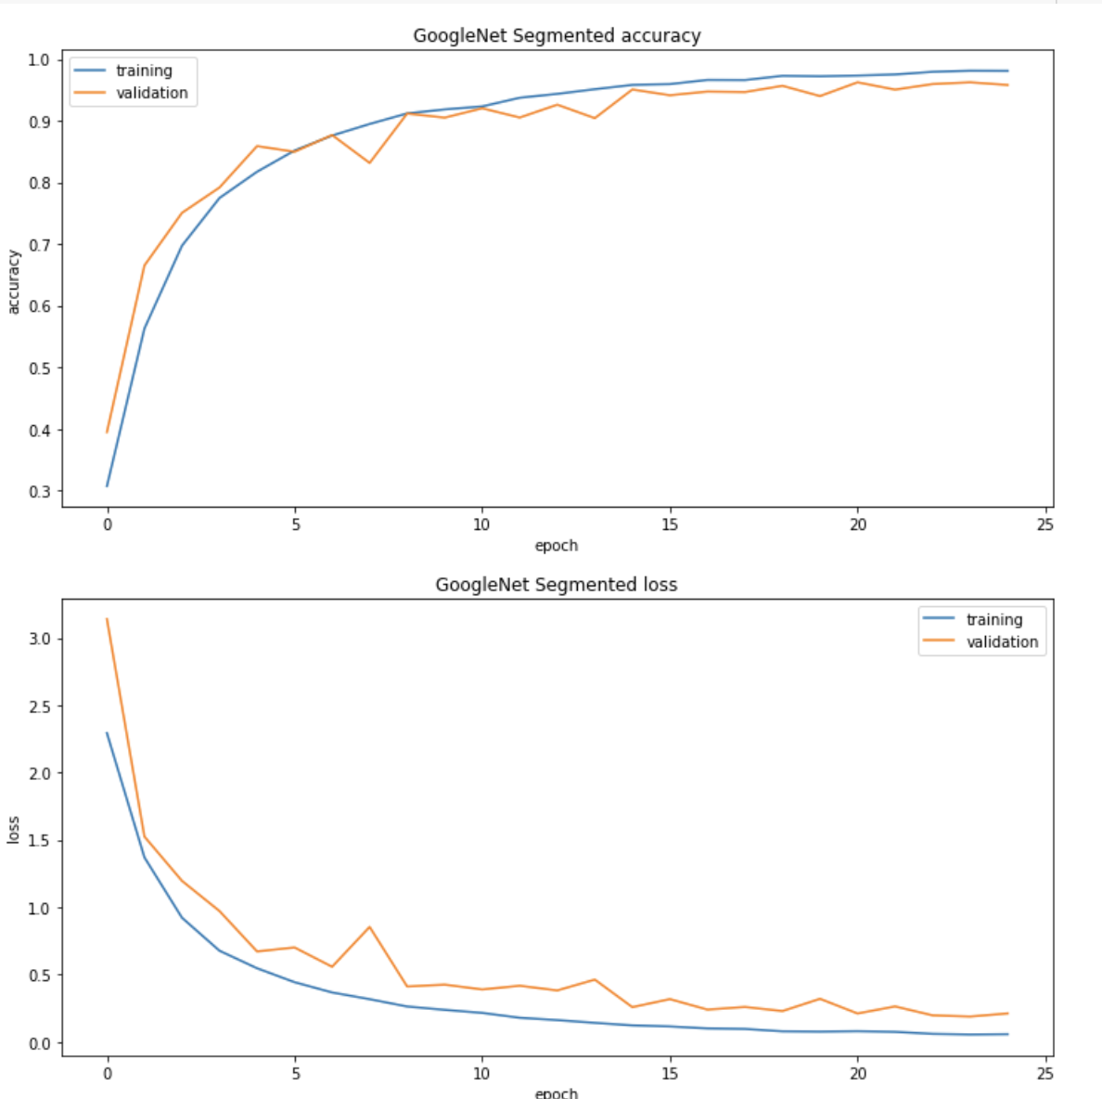
Results
S.No. | Model | Accuracy on Classification
1 | AlexNet - trained on plantvillage dataset | On segmented images- 0.799 On color images-0.749 On grayscale images-0.543
2 | GoogleNet - trained on plantvillage dataset | On segmented images-0.958 On color images-0.942 On grayscale images-0.885
3 | ResNet 50 - pre trained on ImageNet dataset (feature extractor) | On segmented images Classified using SVM-0.846 Classified using RF-0.826
4 | Inception v3 -pre trained on ImageNet dataset (feature extractor) | On segmented images Classified using RF-0.821
5 | Xception -pre trained on ImageNet dataset (feature extractor) | On segmented images Classified using SVM-0.978 Classified using RF-0.777
6 | VGG16 -pre trained on ImageNet dataset (feature extractor) | On segmented images Classified using SVM-0.981 Classified using RF-0.903

Slide 5
Analysis of Results
We know that the main problem with these Convolutional models they tried to overfit the dataset, so during the test time they failed to perform good, as we can see form the graphs also, the models like GoogleNet and AlexNet perform very good on training data but fails to perform good on unseen data.
GoogleNet is better than alex based on speed as well as accuracy; because of less no. of parameters trained. It also performs better on test data, resulting in a smoother curve for accuracy.
VGG16 has better performance than others, because it's much improved version of Inception.
Xception though gives a high accuracy, but relatively fails on test data as compared to VGG16 and GoogleNet. Xception also has the highest no.of layers, ending up extracting much better features than ResNet 50, Inception.
One reason for the failure of ResNet50 and Inceptionv3 on this particular dataset might be overfitting.This happened because both these models have high no. of layers as compared to others.

